Slide 1
Chapter 14
Solutions

Slide 2
Solution - A general term for a solute dissolved in a solvent. A homogeneous mixture of 2 or more components in which particles intermingle at the molecular level.
Solvent - The component of a solution that is the greater quantity.
Solute - The component of a solution that is the lesser quantity.

Slide 3
Common Types of Solutions
Gaseous gas in gas
liquid in gas
Liquid gas in liquid
liquid in liquid
solid in liquid
Solid solid in solid

Slide 4
Gas Solubility
Gases become less soluble as the temperature is raised.
Gases are more soluble at high pressure

Slide 5
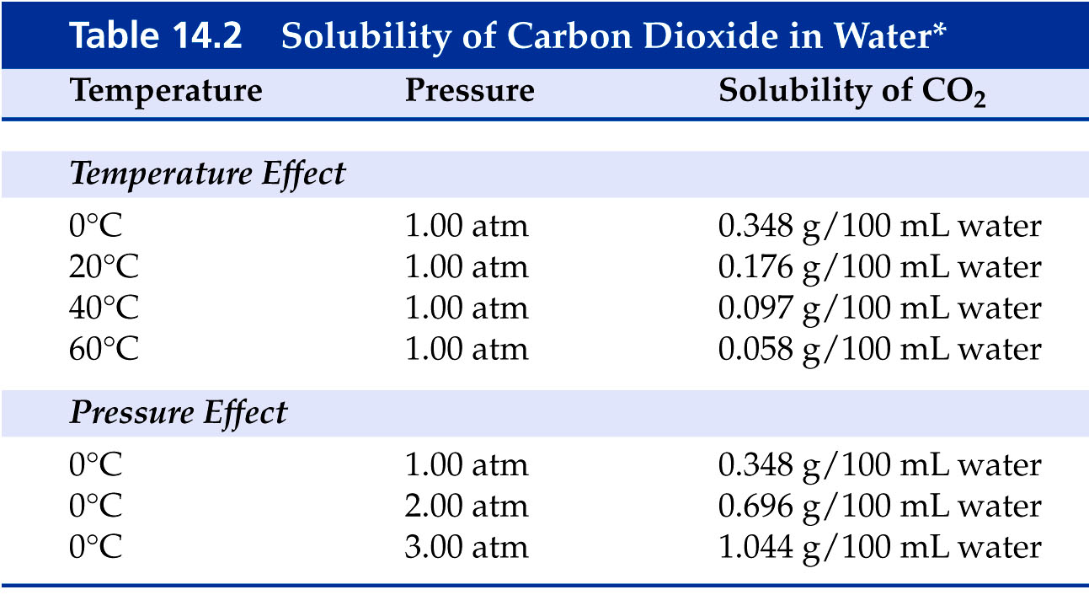

Slide 6
Henry’s Law
The solubility of a gas is directly proportional to its partial pressure above the solution.
Or Solubility = kP
where k = henry’s law constant

Slide 7
Henry’s Law
If the solubility of nitrogen is 1.90 mg/100mL blood at 1.00 atm, what is the solubility of nitrogen in a scuba diver’s blood at a depth of 155 feet where the pressure is 5.50 atm?

Slide 8
Liquids in Solution
Miscible - refers to 2 or more liquids that are infinitely soluble in one another.
Immiscible - refers to 2 liquids that are not soluble in one another and if mixed separate into 2 layers.

Slide 9
Liquids in Solution
General rule – Like dissolves Like
Polar solvents are miscible with polar solutes
Non-polar solvents are miscible with non-polar solutes

Slide 10
Solids in Solution
Follows general rule – Like dissolves Like

Slide 11
What causes substances to dissolve?
Interactions between solute and solvent are stronger than solute/solute and solvent/solvent interactions.

Slide 12
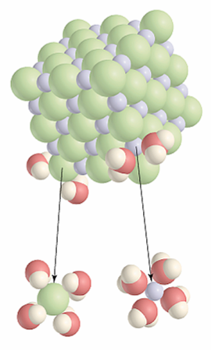

Slide 13
Covalent compounds remain as complete molecules when they dissolve.

Slide 14
Ionic compounds dissociate into ions when they dissolve.

Slide 15
Rate of Dissolving
Determined by
temperature
stirring
particle size

Slide 16
Solubility and Temperature
generally solubility of solids and liquids increases with added heat.
Heat of solution - the amount of energy releases or absorbed when a solute dissolves.
CaCl₂(s) ⎯→ Ca⁺²(aq) + Cl⁻¹(aq) + energy
NH₄NO₃(s) + energy→ NH₄⁺¹(aq) + NO₃⁻¹(aq)

Slide 17
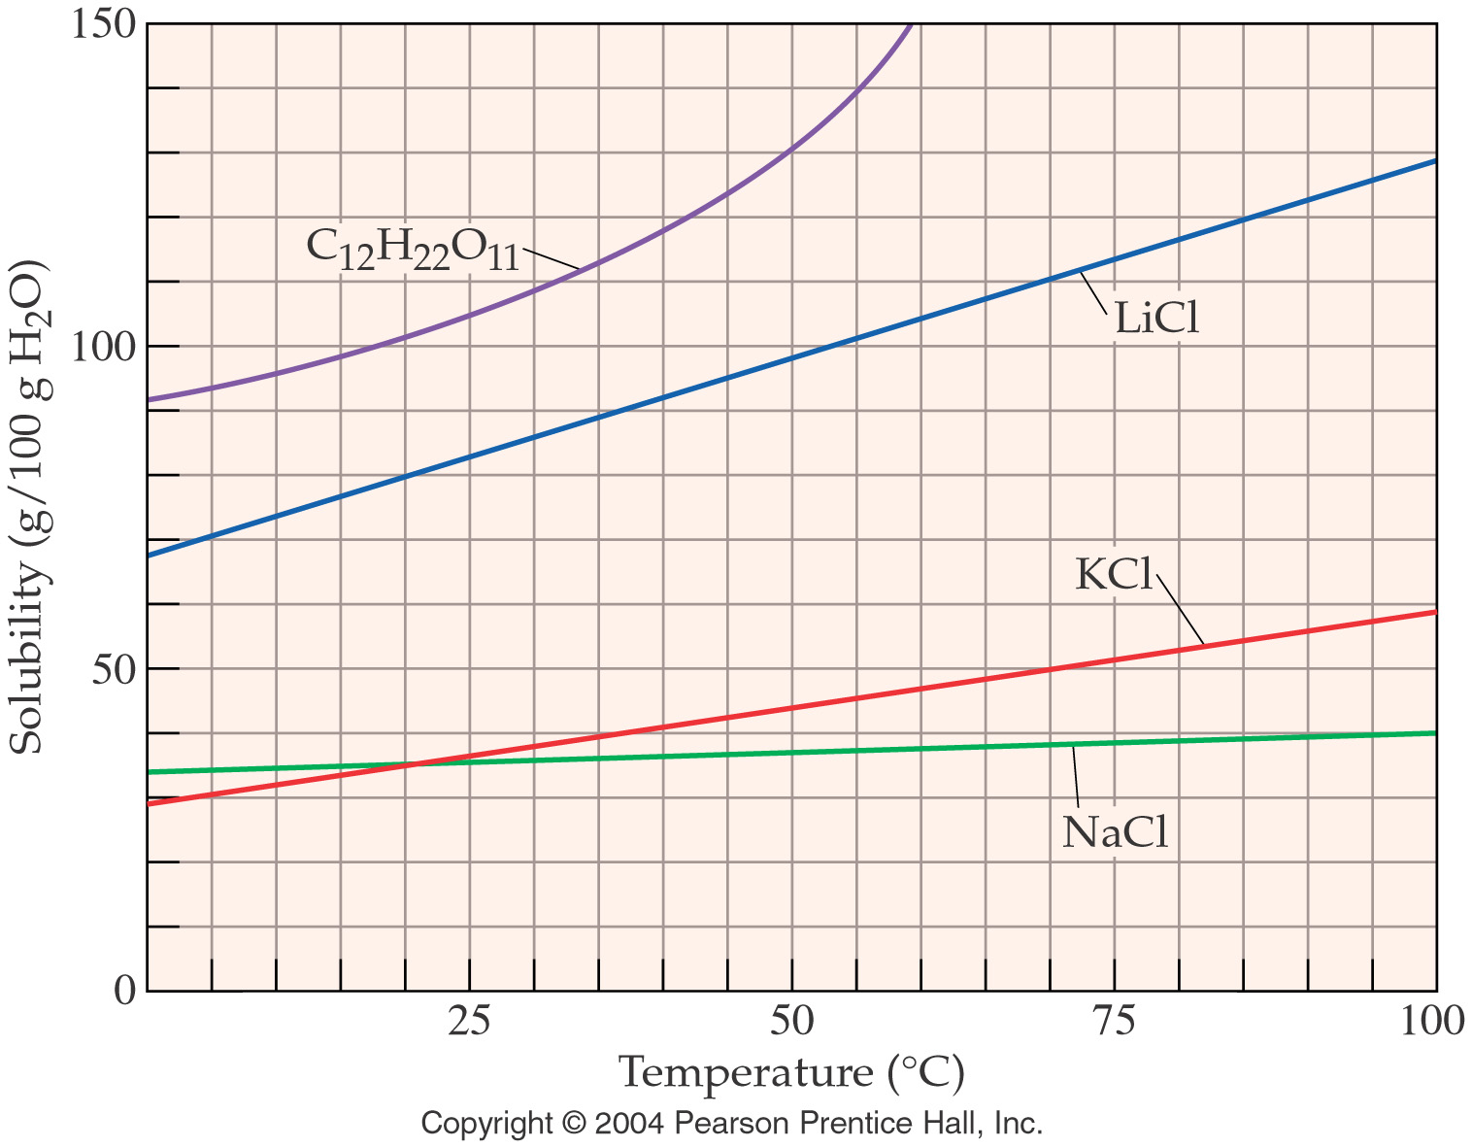

Slide 18
Solubility and Saturation
Saturated solution - a solution that contains the maximum amount of dissolved solute that will dissolve at a given temperature.
Unsaturated solution - a solution that contains less solute than can be dissolved at a given temperature.
Supersaturated solution - a solution that contains more dissolved solute than will ordinarily dissolve at a given temperature.

Slide 19
Solution Concentration Units
Mass Percent (% m/m)
Mass/Volume Percent (% m/v)
Volume Percent (% v/v)
ppm and ppb | Same as % but per million or billion instead of per hundred
Molarity (M)
Molality (m)

Slide 20
Mass percent (% m/m)
A solution consists of 31.7 g of AgNO₃ in 52.0 g of water. What is the mass % of AgNO₃?
A paint requires 42.8 g of iron(III) oxide to give it the correct yellow tint. How many grams of a 30.0% by mass solution of Fe₂O₃ should be used in the paint?

Slide 21
Mass/Volume Percent (% m/v)
Determine the mass volume percent of a solution prepared by dissolving 24.1 g of cadmium chloride in water, giving a final volume of 250. mL of solution.
A 2.65 % (m/v) solution of sodium alginate is prepared for use in an experimental kitchen. How many mL of this solution must be added to a sample of raspberry puree if 0.45 g of sodium alginate are needed to form it into caviar-like spheres?

Slide 22
Molarity M = moles/L
What is the molarity of a sodium hydroxide solution that contains 57.0 g of NaOH dissolved to 300.0 mL total volume?
Calculate the volume in mL of a 2.50 M solution of sodium acetate that will contain 0.650 mol of sodium acetate.

Slide 23
What volume(mL) of 3.0 M ferric chloride can be prepared from 84.0 g FeCl₃? Calculate the mass(g) of HNO₃ needed to prepare 500. ml of a 0.28 M solution?

Slide 24
Dilutions
Calculate the volume of 0.24 M KI needed to prepare 250 ml of 0.15 M KI.
M₁V₁ = M₂V₂

Slide 25
Solution Stoichiometry
We can do stoichiometry using solutions just as we always have.
Calculate the mass in grams of BaSO₄ formed from 0.104 L of 2.00 M H₂SO₄ and excess Ba(OH)₂.

Slide 26
Antacids containing CaCO₃ react with stomach acid according to the reaction
CaCO₃(s) + 2 HCl(aq) ⎯→ CaCl₂(aq) + CO₂(g) + H₂O(l)
How many grams of CaCO₃(s) are needed to react with 53.0 ml of 6.0 M HCl?

Slide 27
Solution properties
Solutions that contains ions conduct electricity.
Electrolyte - a solute that when dissolved in water forms a solution that conducts electricity.
Nonelectrolyte - a solute that when dissolved in water forms a solution that does not conduct electricity.

Slide 28
Colligative properties
properties that depend on the number of particles dissolved in a solution
boiling point elevation
freezing point depression
osmotic pressure

Slide 29
A certain alloy is made by dissolving 5.31 g of copper and 4.03 g of zinc in 145 g of iron. Calculate the percent of each component in the alloy.

Slide 30
How much water must be added to 500.0 mL of 0.200 M HCl to produce a 0.150 M solution? (Assume that the volumes are additive.)

Slide 31
Suppose 1.01 g of FeCl₃ is placed in a 10.0 mL volumetric flask, water is added, the mixture is shaken to dissolve the solid, and then water is added to the calibration mark of the flask. Calculate the molarity of each ion present in the solution.

Slide 32
When aqueous solutions of lead(II) ion are treated with potassium chromate solution, a bright yellow precipitate of lead(II) chomate, PbCrO₄, forms. How many grams lead chromate forms when a 1.00 g sample of Pb(NO₃)₂ is added to 25.0 mL of 1.00 M K₂CrO₄ solution?

Slide 33
Standard solutions of calcium ion used to test for water hardness are prepared by dissolving pure calcium carbonate, CaCO₃, in dilute hydrochloric acid. A 1.745 g sample of CaCO₃ is placed in a 250.0 mL volumetric flask and dissolved in HCl. Then the solution is diluted to the calibration mark of the volumetric flask. Calculate the resulting molarity of calcium ion.

Slide 34
Calculate the molarity of a solution that is 30.0% glucose and has a density of 1.42 g/mL.

Slide 35
Calculate the % acetic acid in a solution of vinegar that is 3.50 M in acetic acid and has a density of 1.06 g/mL.

Slide 36
In class problems
How many grams of calcium nitrate are required to make 500.0 mL of a 0.2221M calcium nitrate solution? Answer 18.22 g
What volume of a 6.217M solution of copper(II) acetate is required to produce 2.177 mol of cupric acetate? Answer 0.3502 L
To what volume must 50.61 mL of 0.9466 M sodium phosphate be diluted to make a 0.3014 M solution of sodium phosphate? Answer 158.9 mL soln

